Slide 1
Shark: SQL and Rich Analytics at Scale
Authors : Reynold Xin, Josh Rosen, Matei Zaharia, Michael Franklin, Scott Shenker, Ion Stoica
Presented By :
Venkata Siva Sai Ram Torlikonda,
Sasleen Reza,
Mouya Praharsha,
K N V Sai Indra Kumar

Slide 2






Shark: SQL and Rich Analytics at Scale

Slide 3
Abstract
Shark is a new data analysis system that marries query processing with complex analytics on large clusters.
It leverages a novel distributed memory abstraction to provide a unified engine that can run SQL queries and sophisticated analytics functions at scale, and efficiently recovers from failures mid-query. This allows Shark to run SQL queries up to 100 times faster than Apache Hive, and machine learning programs more than 100 times faster than Hadoop.
Shark shows that it is possible to achieve these speedups while retaining a MapReduce like execution engine, and the fine-grained fault tolerance properties.

Slide 4

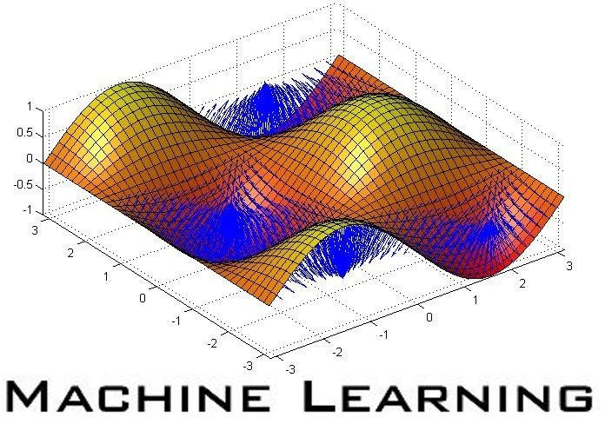
Challenges
Data size growing
» Processing has to scale out over large clusters
» Faults and stragglers complicate DB design
Complexity of analysis increasing
» Massive ETL (web crawling)
» Machine learning, graph processing
» Leads to long running jobs

Slide 5
What’s good about Map- reduce?
Scales out to thousands of nodes in a fault tolerant manner.
Good for analyzing semi-structured data and complex analytics
Elasticity
Dynamic, multi-tenant resource sharing

Slide 6
Cont.
various generalizations offers a fine-grained fault tolerance model suitable for large clusters, where tasks on failed or slow nodes can be deterministically re-executed on other nodes.
MapReduce is also fairly general: it has been shown to be able to express many statistical and learning algorithm. It also easily supports unstructured data and “schema-on-read” property.
MapReduce engines lack many of the features that make databases efficient, and thus exhibit high latencies of tens of seconds to hours.
Even systems that have significantly optimized MapReduce for SQL queries, such as Google’s Tenzing, or that combine it with a traditional database on each node, such as HadoopDB , report a minimum latency of 10 seconds.

Slide 7
Introducing Shark
MapReduce-based architecture
» Uses Spark as the underlying execution engine
» Scales out and tolerate worker failures
Performant
» Low-latency, interactive queries
» (Optionally) in-memory query processing
Expressive and flexible
» Supports both SQL and complex analytics
» Hive compatible (storage, UDFs, types, metadata, etc)

Slide 8
Spark Engine
Fast MapReduce-like engine
» In-memory storage for fast iterative computations
» General execution graphs
» Designed for low latency (~100ms jobs)
Compatible with Hadoop storage APIs
» Read/write to any Hadoop-supported systems, including HDFS, Hbase, SequenceFiles, etc
Growing open source platform
» 17 companies contributing code

Slide 9




















Shark Architecture
Client
CLI
JDBC
Driver
Cache Mgr.
Meta store
SQL
Parser
Query Optimizer
Physical Plan
Execution
Spark
Hadoop Storage (HDFS, S3, …)
REF: https://www.slideshare.net/Hadoop_Summit/spark-and-shark

Slide 10
Extending Spark for SQL
→Columnar memory store Dynamic →query optimization
→Miscellaneous other optimizations (distributed top-K, partition statistics & pruning a.k.a. coarse- grained indexes, co-partitioned joins, …)

Slide 11
Fault tolerance guarantees:
Shark provides the following fault tolerance properties which are difficult to support in traditional MPP database designs
1. Shark can tolerate the loss of any set of worker nodes.
2. Recovery is parallelized across the cluster.
3. The deterministic nature of RDDs also enables straggler mitigation.
4. Recovery works even for queries that combine SQL and machine learning UDFs

Slide 12
Executing SQL over RDDs:
Shark runs SQL queries over Spark using a 3-step process
Query parsing
Logical plan generation
Physical plan generation
Given a query, Shark uses the Hive compiler to parse it and generates an abstract syntax tree.
The tree is then turned to a logical plan and basic logical optimization, predicate pushdown is applied.
Hive, would then convert into a physical plan consisting of map reduce stages.
In Shark, its optimizer applies additional rule based optimizations.

Slide 13
Executing Engines: 1.Partial DAG execution:
Shark and Hive query fresh data that has not undergone a data loading process.
This precludes the use of static query optimization techniques.
So, this requires dynamic approaches to query optimization.
To support dynamic query optimization in a distributed setting, we extended Spark to support partial DAG execution (PDE).
By default, Spark materializes the output of each map task in memory before a shuffle, spilling it to disk as necessary. Later, reduce tasks fetch this output.
PDE modifies this mechanism in two ways.
First, it gathers customizable statistics at global and per-partition granularities while materializing map outputs.

Slide 14
Second, it allows the DAG to be altered based on these statistics, either by choosing different operators or altering their parameters.
These statistics are customizable using a simple, pluggable accumulator API. Some example statistics include
1. Partition sizes and record counts
2. Lists of “heavy hitters”
3. Approximate histograms
These statistics are sent by each worker to the master.

Slide 15
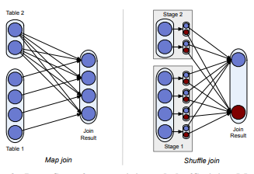
Join Optimization:
Map join broadcasts the small table to all large table partitions
Shuffle join repartitions and shuffles both tables.

Slide 16
Skew handling and degree of parallelism:
The degree of parallelism for reduce tasks can have a large performance impact:
Launching too few reducers may overload reducers’ network connections and exhaust their memories.
launching too many may prolong the job due to task scheduling overhead.
Using partial DAG execution, Shark can use individual partitions’ sizes to determine the number of reducers at run-time by coalescing many small, fine-grained partitions into fewer coarse partitions that are used by reduce tasks.
To mitigate skew, fine-grained partitions are assigned to coalesced partitions using a greedy bin-packing heuristic.

Slide 17
columnar memory store
naive
shark
It collects the data from cache disks.
On-demand serialization in query processor.
Deserialization is bottle neck.
Shark implies combination of naïve and column memory store.
It stores all data partitions as JVM objects.
Query processor use those JVM objects directly.
It avoid the Deserialization.

Slide 18
Limitations in Shark
Storage overheads(12 to 16bytes of overhead per object)
Garbage Collection is time consuming.
Large variability in response times.

Slide 19
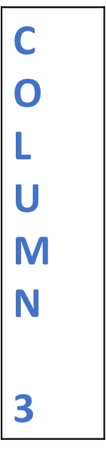
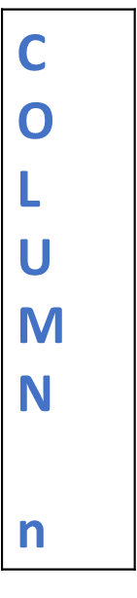


Distributed Data Loading
Max degree Parallelism
T | Row 1
A | Row 2
B | Row 3
L
E | Row n
C O L U M N 1
C O L U M N n
Spark Task 1
Spark Task 3
Column Compression Threshold
Notes:
Table->Split
Uses Data Schema to extract individual fields from rows and store those columns in memory
Threshold decides the column to be compressed or not
Each data loading task tracks metadata to decide whether each column in a partition should be compressed
This allows each task to choose the best compression scheme for each partition
Local partition scheme over global partition scheme
Which do not need coordination – Max degree of parallelism
Remember:
RDD do not contain compression scheme and metadata as they are by-products of RDD computation

Slide 20
Co-Partitioning – A Powerful Feature
2 tables are frequently joined together in warehouse workloads
TPC-H – Decision Support Benchmark supports the same
MPP employs co-partition during data loading
However, most DFS like HDFS being schema-agnostic prevents this.
But Shark joins 2 tables using this feature on a common key for faster joins with DISTRIBUTE BY clause
http://www.tpc.org/tpch/
Notes:
TPC- H
Transaction Performance Processing Council
Consists of a suite of business oriented ad-hoc queries and concurrent data modifications.

Slide 21
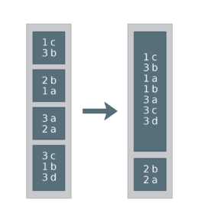
Co-Partition?? → Partitioned the same way
Simple explanation of how “DISTRIBUTE BY” works
Example of a (Key, Value) pair Table
Query:
→SET spark.sql.shuffle.partitions = 2
→SELECT * FROM df DISTRIBUTE BY key
→df.repartition($"key", 2)
https://blog.deepsense.ai/optimize-spark-with-distribute-by-and-cluster-by/

Slide 22
Partition Statistics
Data is stored using some logical clustering on one or more columns
For analytical queries, it is typical to apply filter predicates or aggregations over such columns
For example, a daily warehouse report might describe how different visitor segments interact with the website
Means a predicate is applied on timestamps and aggregations are performed that are grouped by geographical location

Slide 23

Map Pruning
Data Partitions
In-query filter range
Out-query filter range
Resultant Data blocks
“You NeedMe” Block
“Not Me” Block
“You Need Me” Block
After Data Scanning
Avoids scanning certain unwanted blocks of data falling out of query’s filter range
Notes:
Pruning?? –Trimming actually
Process of pruning data partitions based on natural clustering columns
Data -> Small partitions
Means 1 block contains only one or few columns

Slide 24

Piggybacking
Piggybacker
Statistics
M A S T E R
Worker
Column Range &
Distinct Values
Statistics usage:
Evaluates query’s predicates against all partition statistics
Unsatisfying predicates are pruned and no tasks are launched to scan
Image Courtesy : https://fiverr-res.cloudinary.com/t_main1,q_auto,f_auto/gigs/3959996/original/piggybacking.jpg
Notes:
Each worker in the data loading process is piggybacked to collect statistics
Info collected for each partition includes each column’s range and distinct values
Statistics sent back to master program and kept in memory for pruning partitions during query execution
Statistics usage:
Evaluates query’s predicates against all partition statistics
Unsatisfying predicates are pruned and no tasks are launched to scan

Slide 25
Machine Learning Support
Focused at
Providing the shark as a single system capable of efficient SQL query processing and support machine learning .
With the principle of pushing computation to data shark supports machine learning as First-class citizen.
By default this is designed to choose Shark as both EXECUTION ENGINE and RDD as main data structure for the operators.
Using SQL and certain UDF’s and driver programs written in other language it is possible to express certain machine learning algorithms in SQL and avoid moving data out of the database.

Slide 26
Cont.….
The systems become obscure and difficult to maintain; in addition, they may sacrifice performance by performing expensive parallel numerical computations on traditional database engines that were not designed for such workloads.
Contrast this with the approach taken by Shark, which offers in-database analytics that push computation to data, but does so using a runtime that is optimized for such workloads and a programming model that is designed to express machine learning algorithms.

Slide 27
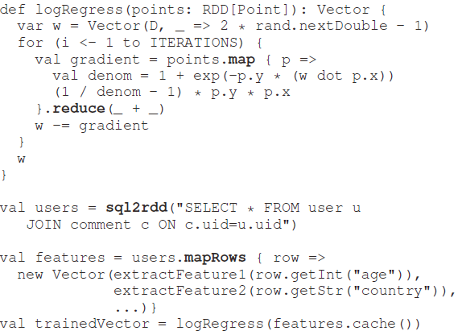
Language Integration
In addition to executing a SQL query and returning its results, Shark also allows queries to return the RDD representing the query plan. Callers to Shark can then invoke distributed computation over the query result using the returned RDD
For Eg:

Slide 28
Cont.
The user can conveniently mix the best parts of both SQL and MapReduce-style programming.
Shark provides native support for Scala, Java and Python.
The Scala shell is modified to enable interactive execution of both SQL and distributed machine learning algorithms.
Shark is built on top of the JVM, it would be relatively straightforward to support other JVM languages, such as Clojure or Jruby

Slide 29
Machine learning algorithms
Linear Regression
Logistic Regression
K-mean Clustering
Notes:
In most cases user only needs to supply amaprows function function to extract can incoke provided algorithms.

Slide 30
Execution Engine Integration
In addition to language integration, another key benefit of using RDDs as the data structure for operators is the execution engine integration.
This common abstraction allows machine learning computations and SQL queries to share workers and cached data without the overhead of data movement coz SQL query processing is implemented using RDD’s lineage is kept for whole pipeline which enables end-to-to end fault tolerance for work flow.
If failures occur during the machine learning stage, partitions on faulty nodes will automatically be recomputed based on their lineage.

Slide 31

MapReduce
Shark
DBMSs

Slide 32
Thank You

